Slide 1
DREAM EndCap detector, engineering specifications
Irina Stefanescu
ESS DG

Slide 2
Background information
Mantle detector
HR detector (TBD)
sample
SANS tank +
Detector (TBD)
beam
Forward detector (identical with the Backward detector)
Backward detector, “EndCap”
The DREAM detector system

Slide 3
2θ
It is an assembly of 12°-sectors, each sector consisting of 4 detector modules (SUMOs)
SUMO = SUper MOdule
12°-sector
𝞅
beam
The DREAM backward (EndCap) & forward detectors

Slide 4
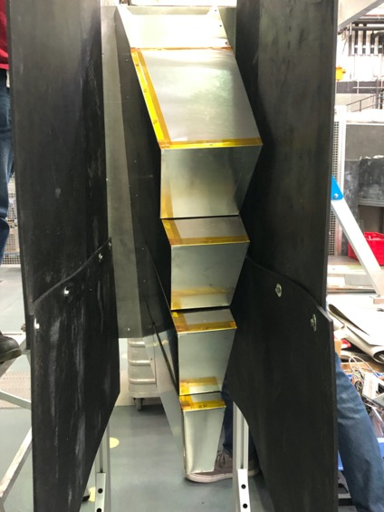
SUMO6
138°
2Θ~7°
𝞅=12°
166°
Neutron beam
Engineering design of the 12°- sector
SUMO3
4 SUMO modules mounted on the same backplate = mounting unit
The DREAM 12°- sector @V20

Slide 5
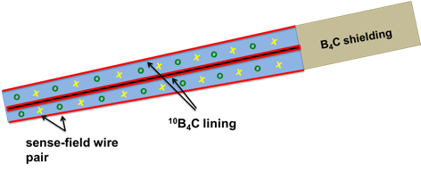
SUMO3
SUMO6
16 wires
16 equal strips
4 segments x 2
10 segments x 2
SUMO4
6 segments x 2
SUMO5
segment
8 segments x 2

Slide 6
SUMO3
SUMO6
16 wires
16 equal strips
16*16*8 voxels
16*16*20 voxels
SUMO4
16*16*10 voxels
Segmentation must ensure that all voxels deliver the same angular resolution Δθ=0.36°
SUMO5
16*16*12 voxels

Slide 7
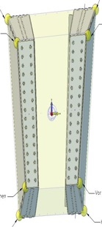
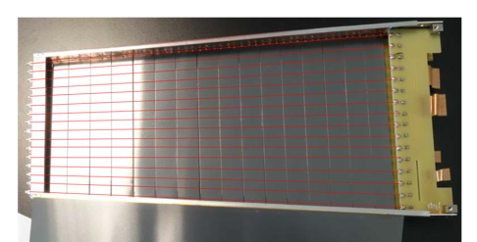
Main design (engineering) parameters for the SUMOs
 | SUMO3 | SUMO4 | SUMO5 | SUMO6
No of cassettes/module | 4 | 6 | 8 | 10
No of counters per module (no of cassettes x 2) | 4x2 | 6x2 | 8x2 | 10x2
No of strips/counter | 16 | 16 | 16 | 16
No of wires/counter | 16 | 16 | 16 | 16
No of (non-identical) voxels/counter | 16x16 | 16x16 | 16x16 | 16x16
No of voxels/SUMO | 4x2x16x16 | 6x2x16x16 | 8x2x16x16 | 10x2x16x16
Engineering specifications, see photos/cartoons for definitions
2θ-scattering angle of the module [deg] | 7.6 | 7.1 | 6.7 | 6.4
2θ-scattering angle covered by the module [deg] | 139-146.6 | 145-152 | 151-158 | 158-165
Radial distance of the sensitive volume from the scattering center [mm] | 1176 | 1249 | 1341 | 1460
Module sensitive depth (Gz) [mm] | 290 | 310 | 324 | 345
Width strip [mm] | =290/16 | =310/16 | =324/16 | =345/16
Thickness cathode strips [um] | 300 | 300 | 300 | 300
Thickness detector housing [um] | 300 | 300 | 300 | 300
Module height front (Gy1) [mm] | 159 | 157 | 160 | 165
Module height back (Gy2) [mm] | 184 | 199 | 201 | 214
Module width top front (Gx3) [mm] | 90 | 124 | 161 | 201
Module width top back (Gx4) [mm] | 103 | 147 | 195 | 243
Module width bottom front (Gx1) [mm] | 57.5 | 93 | 130 | 171
Module width bottom back (Gx2) [mm] | 65.4 | 107 | 145 | 204
Tilt angle module around Y-axis [deg] | 10 | 10 | 10 | 10
Tilt angle module around X-axis [deg] | 10 | 16 | 23 | 30
Width back top (Gx4)
Width front top (Gx3)
Width front bottom (Gx1)
Width back bottom (Gx2)
Height back (Gy2)
Height front (Gy1)
Sensitive depth (Gz)
In the GEANT4 simulations the widths and heights of the individual cassettes of a specific SUMOs were calculated as the ratio
width (heights) module/no of cassettes in SUMO

